Slide 1
Employee Attrition Analysis

Slide 2
Introduction
XYZ company which was established a few years back is facing around a 15% attrition rate for a couple of years.
And it's majorly affecting the company in many aspects.
In order to understand why employees are leaving the company and reduce the attrition rate XYZ company has approached an HR analytics consultancy for analyzing the data they have

Slide 3
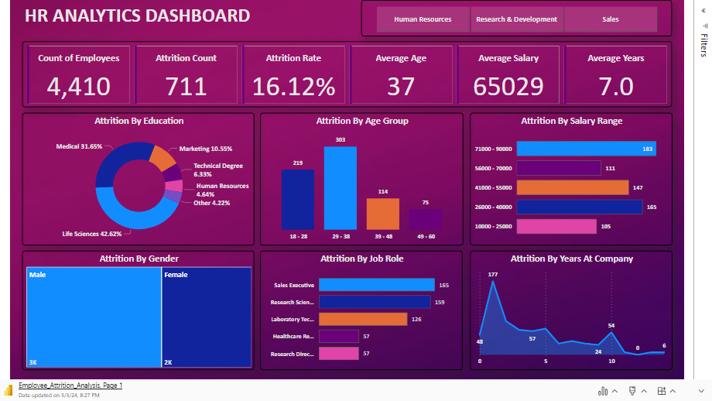

Slide 4

Main KPI’S

Slide 5
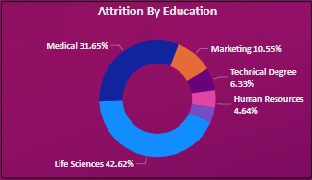

Slide 6
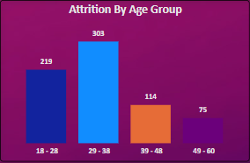

Slide 7
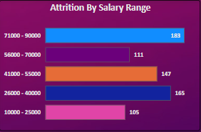

Slide 8
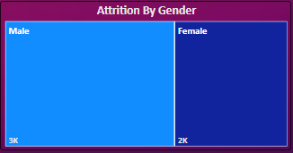

Slide 9
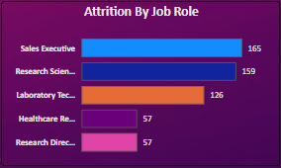

Slide 10
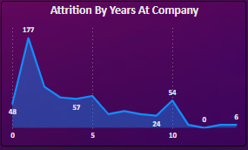

Slide 11
Thank You

